Slide 1


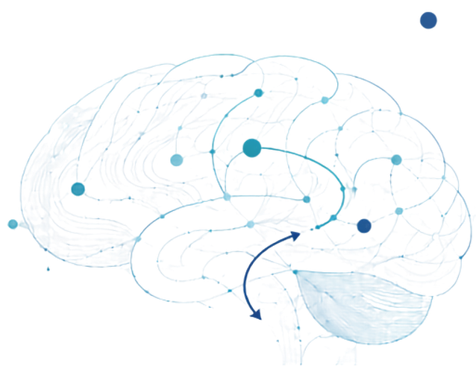

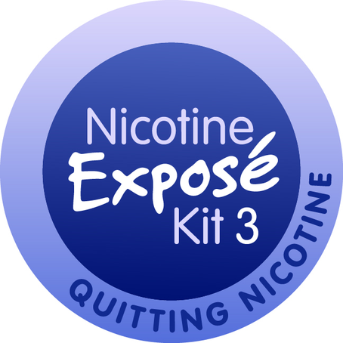
NICOTINE-
Dependence by Design
Understanding nicotine, dependence and quitting.
Notes:
Teacher only note: Before beginning, ensure students know how to access a break or speak privately with a trusted adult if the topic raises a concern.
This presentation is not about judging anyone who uses nicotine. People come to this topic from different experiences—some may use nicotine, some may not, and some may be concerned about a friend or family member.
No one will be asked to share whether they use nicotine or discuss personal experiences. You can think about the information generally, from your own perspective, or in relation to someone you care about.
We are going to look at nicotine objectively: how it affects the brain and body, how dependence develops, how it can affect everyday life, and what kinds of support are available.
The phrase “Dependence by Design” is important. Nicotine products are designed to deliver nicotine effectively and encourage repeated use. When dependence develops, it is not simply a matter of poor choices or weak willpower. It involves real changes in the brain and body.
We will look at the cycle of reward, tolerance and withdrawal, and at how different products can make nicotine easy to access and difficult to measure.
We will also look at practical, confidential supports for anyone who wants more information or is considering making a change.
No one has to make a decision about nicotine today. The goal is to provide accurate information, build understanding and make sure you know where support is available if you—or someone you care about—ever need it.
OPTIONAL OPENING QUESTION:
What do you think people sometimes misunderstand about nicotine dependence?

Slide 2




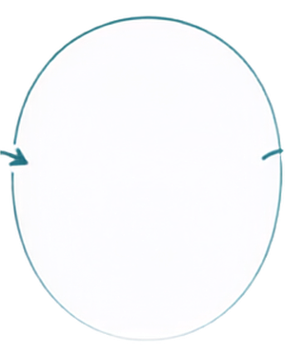

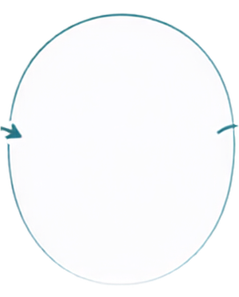

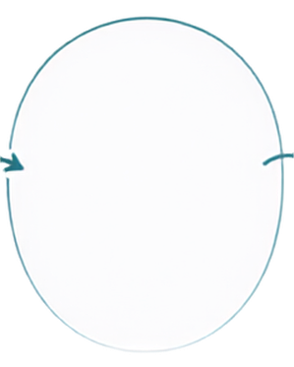

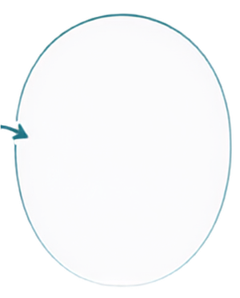


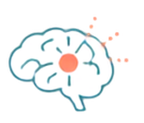

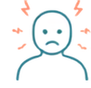
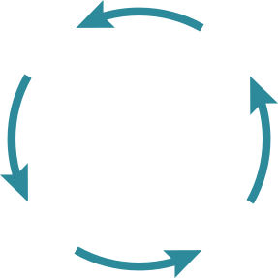

Why Is Nicotine So Addictive?
Dependence can develop quickly because nicotine reaches the brain quickly, changes brain chemistry and relieves withdrawal.
1
2
3
4
5
INHALE
DOPAMINE
TOLERANCE
WITHDRAWAL
REPEAT
Nicotine enters the bloodstream and reaches the brain in 7–10 seconds.
The brain creates more receptors, so more nicotine is needed to get the same response.
When nicotine levels drop, receptors are no longer activated triggering cravings, irritability & anxiety.
Using nicotine again relieves withdrawal symptoms and repeats the cycle.
Nicotine binds to receptors and activates the brain’s reward system.
Notes:
Nicotine dependence can develop quickly because several things are happening at the same time.
First, nicotine is delivered to the brain very rapidly. When nicotine is inhaled, it enters the bloodstream through the lungs and can reach the brain within about 7 to 10 seconds. That speed matters because the brain quickly connects using nicotine with an immediate effect.
Once nicotine reaches the brain, it attaches to receptors and triggers the release of dopamine and other brain chemicals. Dopamine is part of the brain’s reward system. It helps reinforce behaviours by signaling that something is worth repeating.
With repeated nicotine use, the brain begins to adapt. In young people, these changes can begin over a relatively short period, even when use is not yet frequent. The brain creates more nicotine receptors and becomes less responsive to the same amount of nicotine. This is called tolerance. Over time, a person may need to use nicotine more frequently or consume more to get the response they once experienced.
When nicotine levels begin to decline, these receptors are no longer being activated - like an empty lock without the key. This can lead to cravings and withdrawal symptoms such as irritability, anxiety, restlessness, headaches or difficulty concentrating.
Using nicotine again can make those symptoms disappear very quickly. This can make nicotine seem as though it is calming stress or improving someone’s mood. However, for a person who is dependent, much of that immediate relief may actually be the temporary relief of nicotine withdrawal.
That combination of fast delivery, changes in the brain, uncomfortable withdrawal and rapid relief creates a powerful and reinforcing cycle.
It is important to understand that dependence is not a sign of weakness or poor willpower. It is a brain-and-body response to repeated nicotine exposure.
The cycle can become strong, but it can also be interrupted, and support can make that process easier.
OPTIONAL QUESTION:
How can the quick relief of withdrawal symptoms reinforce repeated nicotine use?

Slide 3


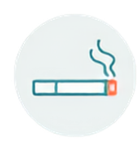


It’s All The Same to Your Brain...
Different products deliver nicotine differently.
CIGARETTES
VAPES
POUCHES
Nicotine comes from tobacco
Uninterrupted use can lead to unmeasurable consumption
Synthetic nicotine is absorbed through oral tissues
Each cigarette burns out, which limits each use
Easy and discreet to use, which can lead to frequent use
Discreet and easy to hide
Use is typically intermittent through the day
Flavors, coolants & easier inhalation can support heavier use
Can initiate, perpetuate or worsen nicotine dependence
Notes:
Nicotine can be delivered through different products and in different ways. Once it reaches the brain, however, nicotine acts on the same receptors and triggers the same basic dependence process, regardless of how it was delivered.
In cigarettes, nicotine generally comes from the tobacco plant. In some newer products, including some vapes and nicotine pouches, the nicotine may be produced synthetically. The brain does not distinguish between nicotine that came from a plant and nicotine that was made in a lab.
The product does make a difference in how nicotine is delivered and how frequently someone may use it. A cigarette burns out, creating a clear beginning and end to each use. Vapes can be used repeatedly throughout the day, sometimes without the person keeping track of how much they have used. Nicotine pouches are discreet and can remain in place for a longer period while nicotine is absorbed through the tissues in the mouth.
These differences can affect how quickly nicotine is delivered, how much is consumed and how easily use becomes part of everyday routines. But when nicotine reaches the brain, it attaches to the same receptors and can contribute to the same process of tolerance, withdrawal and dependence.
This is not meant to suggest that all nicotine products have the same health risks. Cigarette smoke causes especially severe harm because tobacco is burned and smoke is inhaled. The main point here is that switching the form of nicotine does not automatically remove nicotine dependence or other risks.
OPTIONAL QUESTION:
Why might a product that is easy to use throughout the day make it harder for someone to recognize how much nicotine they are consuming?

Slide 4
























What’s in E-Liquid?
It’s not just water vapour...
NIC SALTS + COOLANTS
Base of Propylene Glycol &/or Vegetable Glycerine
Allow higher nicotine concentrations with less throat irritation
26
METALS
AI
Aluminum, Copper, Lead, Silver, Tin
Chemically created flavours mimic fruit and candy tastes that can appeal to young people.
TOXICANTS
Formaldehyde, Benzene
E-liquid is designed to make a nicotine aerosol that is easy to inhale
Notes:
Vaping requires e-liquid. Most nicotine vaping liquids use propylene glycol, vegetable glycerin or a combination of the two as the base. These substances help create the aerosol that is inhaled.
Flavouring chemicals may be added to create fruit, candy, mint or other flavours. A chemical that may be safe to consume in food is not necessarily safe to inhale into the lungs. The lungs are exposed to these substances in a very different way than the digestive system is.
Most vaping products contain nicotine. Nicotine is the drug that can produce dependence and keep someone returning to the product.
There is an important distinction on this slide: some substances are ingredients in the liquid, while others may be created or introduced when the liquid is heated. Heating propylene glycol, glycerin and flavouring chemicals can produce new compounds, including formaldehyde and other toxicants. Metals such as lead, nickel, tin or copper may also enter the aerosol from parts of the device, including the heating coil.
This means the aerosol is not simply water vapour. It can contain nicotine, very small particles, flavouring chemicals, toxic compounds and metals that are inhaled deeply into the lungs. The contents can vary between products and can also be affected by the device, temperature and the way it is used.
The key message is that e-liquid is designed to create an inhalable nicotine aerosol. The fact that the aerosol may smell sweet or disappear quickly does not mean it is harmless.
OPTIONAL QUESTION:
Why might the phrase “water vapour” make vaping seem safer than it is?

Slide 5


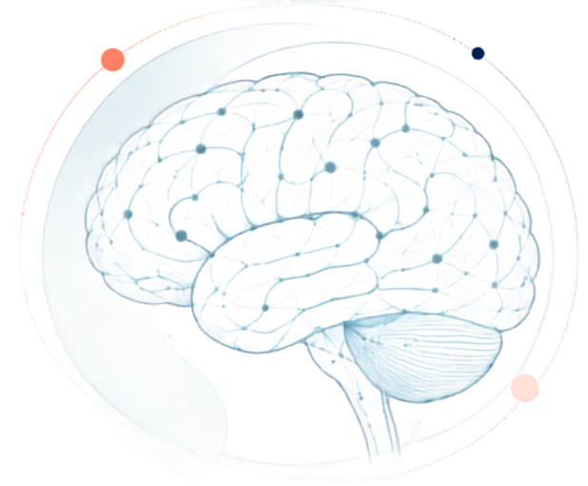

















Teen Brains Are Still Developing
Nicotine can change the way the brain develops, especially in areas linked to learning, mood and dependence.
ATTENTION
Harder to focus and stay on task
DECISION-MAKING
Can affect problem solving, judgment and school performance
MEMORY
Harder to learn and remember
ADDICTION
MOOD
Dependence can happen quickly and may make quitting harder later
More irritability, mood swings and anxiety risk
Brain development continues into the mid-20s.
Notes:
The brain continues developing into the mid-twenties. During the teen years, areas involved in planning, judgment, attention, emotional regulation and decision-making are still maturing.
At the same time, the brain’s reward system is highly responsive. This helps explain why new, exciting or rewarding experiences can feel particularly powerful during the teenage years.
For these reasons, starting earlier is associated with a greater likelihood of developing stronger dependence and having more difficulty quitting later.
Nicotine acts directly on that reward system. It triggers the release of dopamine and begins teaching the brain to connect nicotine with reward, relief or feeling more alert. Because the adolescent brain is still developing, it can adapt to nicotine quickly, and dependence may develop after less exposure than someone expects.
Nicotine can also interfere with areas connected to attention and memory. Students may notice difficulty concentrating when they have not used nicotine, but this does not necessarily mean nicotine is improving their concentration. In someone who is dependent, nicotine may temporarily relieve withdrawal-related distraction before the cycle begins again.
Mood can also be affected. Changes in nicotine levels can contribute to irritability, restlessness, anxiety or mood swings. This can make it difficult to separate the effects of nicotine withdrawal from ordinary stress or emotions.
The important point is that nicotine is interacting with a brain that is still developing and is particularly responsive to reward and dependence. Because the areas involved in judgment, planning and self-regulation are still developing while the reward system is highly responsive, adolescents can be particularly vulnerable to nicotine dependence. This heightened vulnerability also applies to other addictive substances.
OPTIONAL QUESTION:
Why might a developing reward system make teenagers more vulnerable to nicotine dependence?

Slide 6

















The Chemical Cascade
Nicotine triggers multiple brain chemicals to be released at once.
1
DOPAMINE
Reward, motivation & reinforcement
3
SEROTONIN
ENDORPHINS
Calming effects & mood regulation
Pleasure & reduced pain perception
NOREPINEPHRINE
These combined effects can reinforce continued nicotine use.
Alertness, attention and energy
Notes:
This slide gives us a simplified picture of what happens when nicotine reaches the brain.
Nicotine is similar enough in shape to one of the brain’s natural chemical messengers, acetylcholine, that it can attach to the same receptors. Once those receptors are activated, they trigger the release of several brain chemicals at the same time. These chemicals are part of normal brain function, but nicotine changes when and how strongly they are released.
Dopamine is especially important because it is involved in reward, motivation and learning. The release of dopamine helps teach the brain that nicotine use is something worth repeating. This is one of the strongest mechanisms reinforcing continued nicotine use.
Nicotine can also influence norepinephrine, which is associated with alertness, attention and energy. This helps explain why someone may briefly feel more awake or stimulated after using nicotine.
Serotonin helps regulate mood. Endorphins are part of the body’s natural pain-control and reward systems. Nicotine can influence their release, which may briefly reduce the perception of pain or discomfort and contribute to feelings of pleasure. These effects are temporary, but they can add to the overall reinforcement of nicotine use.
As nicotine is broken down and cleared from the body, the chemical response fades. For someone who has developed dependence, this drop may be followed by cravings, irritability, restlessness or difficulty concentrating.
Using nicotine again can relieve those withdrawal-related feelings. That rapid relief reinforces the connection between withdrawal discomfort and nicotine use, strengthening the dependence cycle.
The main point is that nicotine changes the brain’s natural chemical signaling, and repeated exposure can teach the brain to rely on nicotine to create those effects.
Optional question:
How might a rapid but temporary chemical effect encourage someone to keep using nicotine throughout the day?

Slide 7


















Dependence in Real Life
Nicotine dependence can start affecting everyday life in noticeable ways.
1
SOON AFTER WAKING
2
CRAVINGS & WITHDRAWAL
3
IMPACTS LEARNING
4
AFFECTS DAILY LIFE
5
CHANGE IS POSSIBLE
Feeling the need to use nicotine soon after waking can be a sign of stronger dependence.
When nicotine levels drop, people may feel cravings, irritability and anxiety.
Thinking about vaping, leaving class or struggling to focus can interfere with learning.
Dependence can affect mood, sleep, sports, money, stress and relationships.
Dependence is real, but people can reset with support.
Notes:
Dependence does not always become obvious all at once. It may begin with small changes that gradually start shaping someone’s day.
One strong sign of developing dependence is needing nicotine soon after waking up. Nicotine levels fall overnight, so reaching for a vape or another nicotine product early in the morning may mean someone is relieving withdrawal symptoms and/or is unintentionally creating automatic behaviours (routines) around nicotine use.
As nicotine levels continue to rise and fall throughout the day, a person may experience cravings, irritability, anxiety, restlessness or difficulty concentrating. These symptoms can feel like ordinary stress, but they may actually be the brain responding to changing nicotine levels.
Dependence can begin interfering with learning. Someone may be thinking about when they can use nicotine again, struggling to focus, leaving class, missing parts of lessons or becoming distracted by cravings. Using nicotine may briefly relieve those feelings, but the relief is temporary and reinforces the cycle.
Nicotine use can also affect other parts of life, including sleep, mood, sports, relationships, money and daily routines. A person might begin planning where they can vape, worrying about running out or avoiding situations where nicotine use will be difficult.
Not everyone will experience every sign. These are simply indicators that nicotine may be having more influence on daily life than intended.
The final message here is important: change is possible. Dependence is real, but it is not permanent, and it is not a personal weakness. Cravings and withdrawal can be managed, routines can be changed and support is available.
OPTIONAL QUESTION:
How can nicotine dependence gradually begin to shape a person’s day before they fully recognize it?

Slide 8




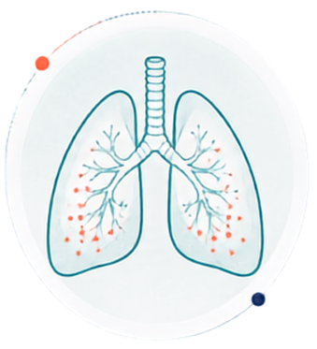
Your
HEART & LUNGS
Nicotine affects the cardiovascular system, and vaping aerosol can irritate the lungs.
HEART
LUNGS
Raises Blood Pressure
Inflammation
Shortness of breath
Increases Heart Rate
Cough
Damages Blood Vessels
Long-term effects still
being studied
Notes:
Nicotine is classed as a stimulant, so it speeds up the cardiovascular system. Shortly after nicotine is used, heart rate and blood pressure can increase. Nicotine can also cause blood vessels to narrow and become more rigid. These effects stress the heart and circulatory system.
These effects do not necessarily produce symptoms that a young person immediately notices. A person may not feel their blood pressure rising or recognize changes in blood-vessel function, but that does not mean that the cardiovascular system is unaffected.
The effects on the lungs are related mainly to inhaling the aerosol. Chemicals and fine particles in vape aerosol can irritate the airways from the nose and throat through to the deeper parts of the lungs. The aerosol carries fine particles and chemicals directly (and deeply) into lungs where they enter the bloodstream and then circulate around the body.
Some young people who vape report coughing, wheezing, chest discomfort or shortness of breath. Vaping may also intensify asthma symptoms. The effects can vary depending on the product, how often it is used and what is contained in the aerosol.
There are decades of research available on smoking and the effects of nicotine. Although vaping products are still relatively new, evidence is accumulating and identifying many risks. Research on the LONG-TERM use of vaping products is still developing. This means researchers are continuing to determine the full extent of health effects that may emerge after many years of exposure.
The key takeaway is that the potential harms from vaping are not limited to the brain or to dependence. Nicotine places stress on the cardiovascular system, while inhaled aerosol directly exposes the lungs to substances that can cause irritation and inflammation.
OPTIONAL QUESTION:
Why might it be difficult to recognize health effects that develop gradually or do not cause immediate symptoms?

Slide 9



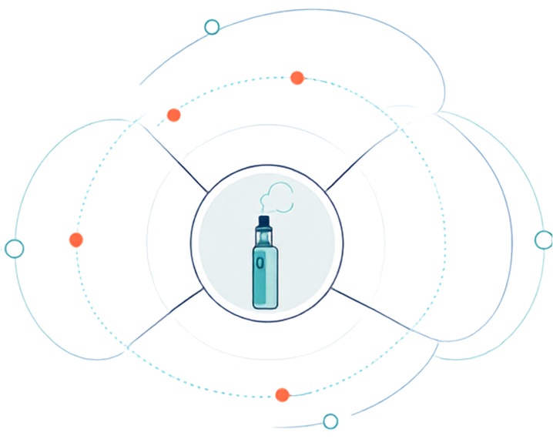



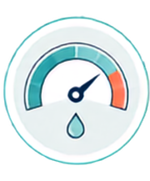
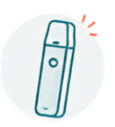
Addiction by Design
The industry targets youth.
SOCIAL MEDIA & INFLUENCERS
SWEET FLAVOURS
Stylized images
Influencer marketing
Content that can make nicotine use look normal
Candy, fruit and mint flavours can increase appeal to young people.
HIGH NICOTINE DELIVERY
SLEEK & DISCREET
Dependence can drive repeated use and long-term sales.
Easy to hide. Easy to access and use frequently.
The industry needs new generations of customers.
Dependence keeps customers using and buying.
Notes:
This slide asks us to look beyond individual behaviour and examine how nicotine products are designed, presented and marketed.
Companies need people to begin using their products and continue buying them. Product design and marketing can make nicotine use seem appealing, convenient and normal, especially to younger audiences.
Sweet flavours are one part of this. Fruit, candy, mint, menthol and dessert flavours can reduce the harshness of the first experience and make the product seem more familiar or appealing. Flavour does not make the nicotine or aerosol safer; it can make the product more appealing.
Social media can also shape perceptions. Carefully styled images, paid influencers and trendy content may present nicotine use as part of a desirable lifestyle while leaving dependence and health risks out of the picture. Sometimes the marketing is obvious, but other times it blends into entertainment or ordinary online content.
The products themselves are often sleek, discreet and easy to carry or conceal. Unlike a cigarette, a vape does not burn out after a few minutes. It can remain available throughout the day, making repeated use easier and making consumption more difficult to track.
High nicotine concentrations also matter. Nicotine creates dependence, and dependence can lead to repeated use and repeated purchasing. From a business perspective, continued customers mean continued sales.
This does not mean that every person who uses nicotine was deliberately manipulated or lacks personal responsibility. It means that individual decisions are being made in an environment shaped by product engineering, marketing and commercial interests.
BE INTENTIONALLY DIRECT HERE:
The industry needs people to begin using nicotine products and continue purchasing them. Young people matter to that future market because they represent a new generation of potential customers. Dependence can extend nicotine use over time, which also means continued sales.
The consumer pays financially and may also experience dependence and health effects.
Recognizing these strategies can help people make more informed decisions. Understanding influence does not automatically change behaviour, but it gives people an opportunity to recognize and question that influence.
OPTIONAL QUESTION:
Do you think youth would be vaping as much if there were no flavours and the devices were less convenient?
While these practices may be legal, what responsibility should governments have in protecting young people from influences that promote nicotine use?

Slide 10












Nicotine MATH
The total nicotine in vaping devices can be much higher than many people realize.
FOR COMPARISON
Concentration
Volume
=
40
1 cigarette ≈ 1 mg of nicotine absorbed
20
mg/ml
mg
20
mg per ml
2.0
ml
of nicotine
Using a 2 mL pod containing 40 mg of nicotine each day can result in substantial nicotine exposure.
High nicotine exposure can increase tolerance, withdrawal and dependence.
Notes:
This slide shows how nicotine content is calculated in a vaping product.
The nicotine concentration tells us how many milligrams of nicotine are present in each milliliter of liquid. In this example, the liquid contains 20 milligrams of nicotine per milliliter. (This is the maximum permitted in Canada)
The vape device in this example contains 2 milliliters of liquid. (Some very popular devices used by teens hold 15, 20 mg of e-liquid or more)!! (TEACHER: You can do that math on the white board as another example if you wish).
To calculate the total nicotine contained in the device, we multiply the concentration by the volume:
20 milligrams per milliliter multiplied by 2 milliliters equals 40 milligrams of nicotine.
The milliliter units cancel out, leaving us with the total number of milligrams of nicotine in the liquid.
It is important to understand what this number does and does not tell us. It tells us approximately how much nicotine is CONTAINED IN THE DEVICE in the device. It does not tell us exactly how much nicotine will enter a person’s bloodstream.
The amount ABSORBED can vary depending on the device, how deeply and frequently the person inhales, how long the device is used and whether all the liquid is consumed. Some nicotine may remain in the device or be released without being absorbed.
The cigarette is intended to provide a comparison. A person typically absorbs approximately one milligram of nicotine from smoking one cigarette. The cigarette figure refers to nicotine absorbed into the body, while the vaping figure tells us how much nicotine is contained in the liquid. How much nicotine is absorbed from a vape varies with the device and how it is used.
A 2 mL pod containing 40 mg of nicotine represents a substantial amount of nicotine, even if it is consumed in a day or over several days. Regular exposure at this level can contribute to tolerance, withdrawal and dependence, HOWEVER there are effective ways to manage dependence and reduce nicotine use.
OPTIONAL QUESTION:
Why might people underestimate nicotine consumption when there is no clear beginning or end to each use?

Slide 11

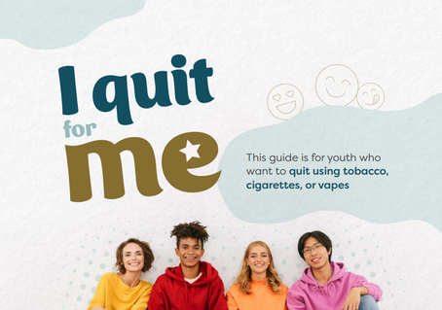



Thinking about quitting?
Health Canada
youth quit guide
NL Smokers’ Helpline support for quitting vaping
Practical tool for cravings and change
  Youth-focused
  Self-guided support
  Practical quitting strategies
  Text, online & phone support
  Confidential
  Built for youth and young adults
  Stress management
  Reflection tools
  Find online: www.truthaboutvaping.ca
You can explore support even if you’re not ready to make a change.
Notes:
NOTE TO TEACHER: Before presenting, familiarize yourself with how to access each resource so you can show students where to find them. I Quit for Me and Exit the Vaping Experience can be found through a simple online search. V-SHIFT is available through the Youth section at www.truthaboutvaping.ca.
People may come to these resources for different reasons. Some may be curious, some may be considering a change, and others may want information to support a friend or someone they care about. These resources are available for anyone who wants information or help.
Seeking support does not require someone to have everything figured out. A person does not need to wait until their dependence becomes severe, and they do not need to commit to quitting before exploring these resources.
I Quit for Me is a Health Canada guide developed for young people. It is self-directed, which means someone can work through it privately and at their own pace. It includes practical strategies for preparing to quit, managing cravings and responding to situations that may make nicotine use more difficult to avoid.
Exit the Vaping Experience is available through the Newfoundland and Labrador Smokers’ Helpline. It provides confidential support by text, online or by phone. The support is designed for youth and young adults and can help someone create a realistic plan, manage withdrawal and work through challenges as they arise.
V-SHIFT is a youth nicotine self-help tool available online at www.truthaboutvaping.ca.
We are going to look more closely at V-shift on the next slide. It is meant to put information about nicotine, dependence and change in your pocket for whenever you want it.
OPTIONAL QUESTION:
Which of these types of support (self-guided, text/chat or practical tools) might be most useful to young people, and why?

Slide 12















More About
?
Private
Practical
At your own Pace
UNDERSTAND NICOTINE
NOTICE THE PATTERNS
NAVIGATE WITH SUPPORT
  Signs of dependence
  Nicotine’s influence on daily life
  Manage cravings and plan for challenges
  Recognize cravings & withdrawal
  Explore triggers & routines privately
  Take realistic small steps at your own pace
  Understand why quitting can feel difficult
  Build alternative coping strategies
  Connect with confidential support
Find V-SHIFT online at www.truthaboutvaping.ca
Notes:
V-SHIFT is a private, youth-focused self-help tool for anyone who wants to better understand nicotine use or who is considering making a change.
The first section helps users understand nicotine. It explains common signs of dependence, recognizing withdrawal symptoms and why quitting may be more difficult than simply deciding to stop. Understanding what is happening in the brain and body can make the experience feel less confusing and more manageable.
The second section helps users notice patterns. Within the privacy of the tool, they can explore triggers and routines, notice when and why nicotine use may occur, and consider how nicotine can influence daily life, including mood, focus, sleep, relationships, money and activities.
The third section helps users navigate with support. It offers practical ways to manage cravings, build alternative coping strategies and plan for situations that may be challenging. It also encourages realistic small steps rather than expecting immediate or perfect change.
V-SHIFT can be used by someone who is ready to quit, someone who wants to reduce their use, or someone who is simply curious about their own patterns. There is no pressure to make a particular decision, and users can move through the tool privately and at their own pace.
It also connects young people with confidential support when they want additional help.
The goal of V-SHIFT is not to tell someone what they should do. It is to provide accurate information, practical tools and support so they can decide what their next step might be.
You do not need to be ready to quit to begin understanding your nicotine use.

Slide 13








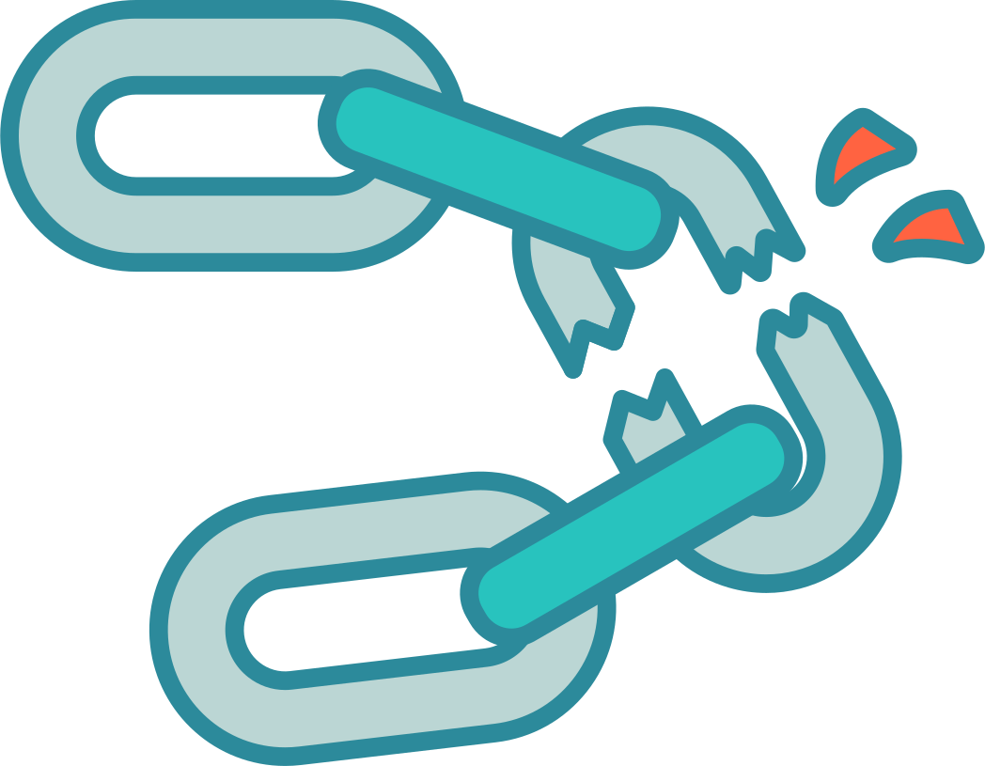
The Take-Aways...
1
2
3
4
Nicotine products are designed to keep people coming back.
Dependence can happen faster than expected.
Nicotine dependence can be overcome.
Quitting support is available for anyone considering a change.
You decide what happens next...
Notes:
Before we finish, there are four main points to remember.
First, nicotine products are designed to encourage repeated use. The way nicotine is delivered, the concentration of nicotine, the flavours, the discreet design and the ability to use some products throughout the day can all make continued use more likely.
Second, dependence can develop faster than someone expects. It does not always begin with a clear moment when a person realizes they are addicted. It may show up gradually through cravings, using soon after waking, difficulty concentrating without nicotine or planning the day around opportunities to use.
Third, dependence does not have to be permanent. Nicotine changes the brain and body, but those changes do not mean a person is weak or incapable of stopping. Cravings and withdrawal can be managed, routines can be changed and the brain can begin adjusting to functioning without nicotine.
Quitting or reducing nicotine use may take more than one attempt. A difficult day or a return to use does not erase progress or mean someone has failed. Change is often a process rather than one single decision.
Finally, quit support is available. Some people may want help quitting completely, while others may begin by learning more, noticing their patterns or considering a small change. Support can include practical strategies, confidential services and tools designed specifically for young people.
No one has to make a decision in this classroom or share personal information. The purpose of this presentation is to make sure everyone understands how nicotine dependence works and knows where to find support if they, or someone they care about, ever want it.
The final message is that nicotine dependence is powerful, but it does not have to control what happens next.
OPTIONAL QUESTION:
What is one fact from this presentation that you think people your age should understand about nicotine and dependence?

Slide 14










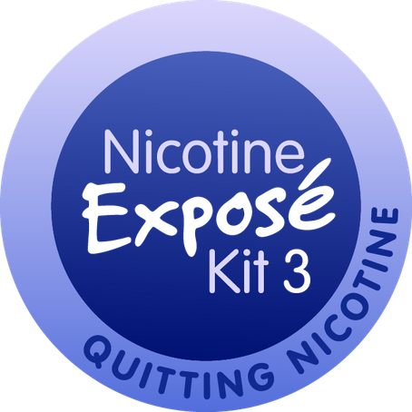




Questions & Discussion
A space to ask questions, reflect, or talk further.
Notes:
NOTE TO TEACHER:
Following this presentation, you can introduce the Student Workbooks (same class or later as time permits).
This is a chance for the class to ask questions, clarify anything that was unclear, or talk more about something that stood out.
No one needs to share personal experiences or identify whether they use nicotine. Questions can be general, hypothetical, or about supporting someone else.
If a question comes up that we cannot answer today, that is okay. We can identify where to find reliable information or additional support.
The main thing to leave with is this: nicotine dependence is real, but it can be understood, managed and overcome with support. Knowing how nicotine works gives people more information and more options.
..............
If the class is quiet or slow to start:
- What is one thing from today that surprised you, changed how you think about nicotine, or raised a question for you?
-What stood out to you most today?
-What surprised you?
-What made you think differently?
-What questions are you still thinking about?
-Why do you think nicotine dependence can be hard to recognize at first?
-What might make quitting easier for someone your age?
-What kinds of support do you think young people are most likely to use?
-If you were explaining one thing from today to a friend, what would you tell them?

