Slide 1

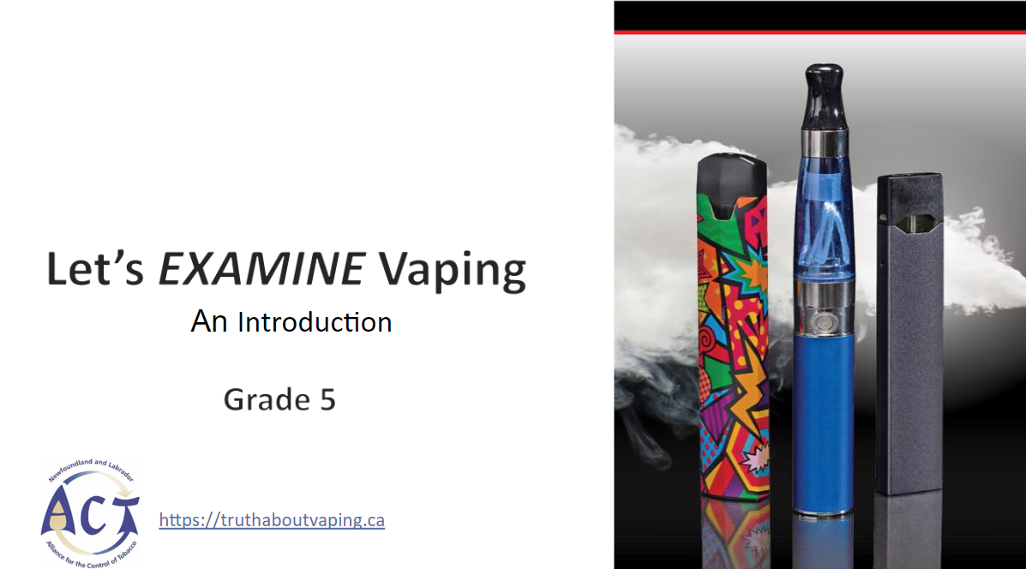
EXPOSING THE FACTS ABOUT VAPING
Vaping - The EX-Files, Let’s EXPOSE Vaping, Grade 6

Slide 2
HOW TO PLAY
There are 3 different types of questions:
Answer the question
Multiple choice
True or false

Slide 3
Do you know what a vape is?
Raise your hand for yes...

Slide 4
ANSWER
A vape is an electronic cigarette

Slide 5
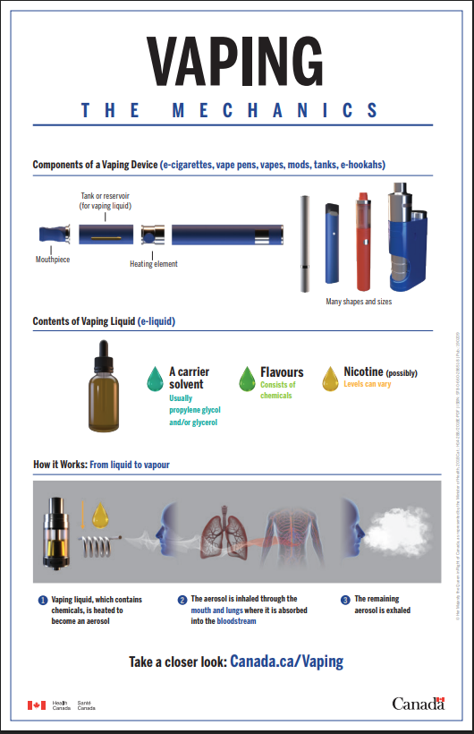

A battery heats a coil, that heats a liquid so people can inhale the aerosol.
They are different from cigarettes because they do not burn tobacco.
Vape liquids usually contain nicotine, the same drug found in cigarettes.

Slide 6
Nicotine from vapes is just as addictive as nicotine from cigarettes.
TRUE
FALSE

Slide 7
Nicotine from vapes is just as addictive as nicotine from cigarettes.
TRUE
FALSE

Slide 8


Let’s Talk about Nicotine
Nicotine has the same chemical structure no matter where it comes from.
Vaping can deliver very high amounts of nicotine.
Nicotine is a drug. It can be hard to stop using it once you start.

Slide 9
What is one way that nicotine changes your brain?
A. Seizures
B. Learning difficulties
C. Better recall
D. All of the above

Slide 10
What is one way that nicotine changes your brain?
A. Seizures
B. Learning difficulties
C. Better recall
D. All of the above

Slide 11
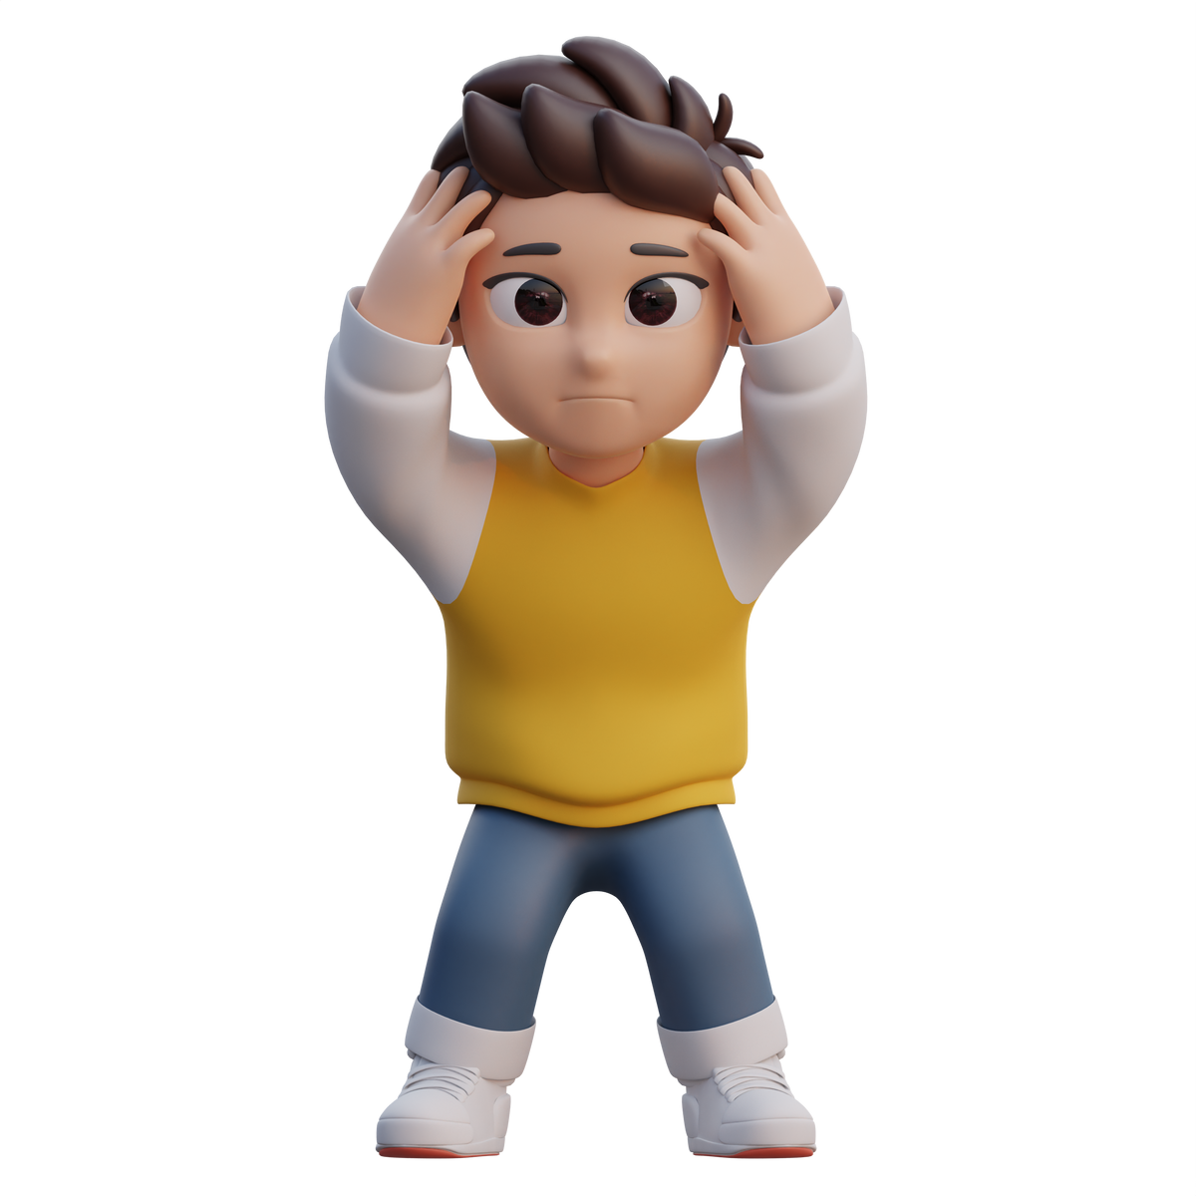
Nicotine negatively affects your brain. It causes:
- mood swings
- anxiety
- depression
- learning difficulties
The human brain is not fully developed until age 25
Young brains are more vulnerable to the effects of nicotine and addiction

Slide 12
What do you think being addicted to nicotine would feel like?
A. Feeling relaxed and chill all the time
B. Feeling cool and accepted by peers
C. Feeling stressed and anxious
D. Feeling mature and grown-up

Slide 13
What do you think being addicted to nicotine would feel like?
A. Feeling relaxed and chill all the time
B. Feeling cool and accepted by peers
C. Feeling stressed and anxious
D. Feeling mature and grown-up

Slide 14
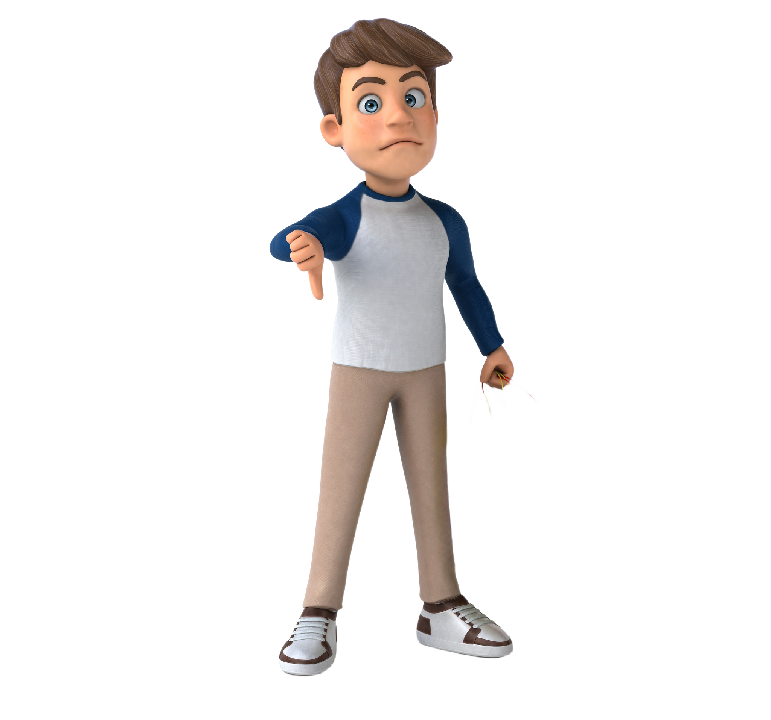
Nicotine is a highly addictive drug.
That means once you start using it, your body and brain can quickly start to need it just to feel normal.
Being addicted to nicotine can look like:
Constantly thinking about vaping during the day
Planning your day around when you can vape
Feeling stressed, irritated, or anxious when you can’t vape
Having trouble focusing or sleeping without it
Needing more nicotine over time to get the same feeling
Notes:
“Let’s talk about what it really means when we say nicotine is addictive—especially for teens.”
Slide Point: Nicotine is a highly addictive drug.
Speaker Notes:
“Nicotine affects the brain’s reward system. When someone vapes, nicotine creates a quick feeling of pleasure or calm. But that feeling doesn’t last long, so the brain starts craving more and more. That’s how addiction starts. It’s not just a bad habit—it’s a brain change.”
Slide Point: Constantly thinking about vaping during the day
Speaker Notes:
“People addicted to nicotine often find themselves thinking about their next vape session even when they’re supposed to be focused—like during school, sports, or hanging out with friends. For example, someone might be in class, not paying attention to the lesson, but instead thinking about when they can sneak a vape break.”
Slide Point: Planning your day or breaks around when you can vape
Speaker Notes:
“This can look like choosing to go to the bathroom not because you need to go, but because you need a place to vape. Or avoiding places where vaping isn’t allowed—like long movie nights or a family dinner—because you’re worried you won’t get your ‘fix.’”
Slide Point: Feeling stressed, irritated, or anxious when you can’t vape
Speaker Notes:
“When someone is addicted, not having nicotine in their system can cause withdrawal symptoms. These include being easily irritated, anxious, or even feeling physically uncomfortable. You might notice someone getting really frustrated or on edge if they can’t vape for a few hours.”
Speaker Notes:
“When someone becomes addicted to nicotine, their brain starts depending on it to function normally. Without it, they might feel foggy, distracted, or restless. This can make it hard to focus during class, study for a test, or even finish homework.
It can also mess with sleep. You might find it harder to fall asleep or wake up feeling tired because your brain is craving nicotine—even overnight. So instead of helping you relax, vaping can actually leave you more stressed and exhausted.”
Example:
“You might hear someone say they can't fall asleep unless they vape before bed—or they wake up in the middle of the night needing to hit their vape. That’s not normal—that’s a sign of dependence.”
Slide Point: Needing more nicotine over time to get the same feeling
Speaker Notes:
“This is called tolerance. When you first start using nicotine, a small amount might give you a buzz or help you feel calm. But over time, your brain gets used to it. That same amount doesn’t do much anymore, so you start needing more—more hits, stronger products, or vaping more often—to feel anything at all.
That’s how addiction builds. It’s not just about using regularly—it’s about needing more and more just to keep up with what your brain now expects.”
Example:
“Someone might start out taking a few puffs once a day, but months later, they’re carrying their vape everywhere and hitting it between every class. That’s their tolerance growing—and it’s a red flag.”
Teacher may also add this example:
Choosing to hang out in places or with people where vaping is allowed
Speaker Notes:
“This can impact someone’s social life. Instead of choosing activities they enjoy or people they feel safe around, they might pick places or friend groups that make it easier to vape. It shifts their priorities and limits healthy choices.”
Additional Talking Point (optional):
“Nicotine doesn’t just affect your mood—it can change how your brain develops. Teen brains are still growing, and using nicotine can interfere with memory, attention, and emotional control. That’s why addiction can feel especially overwhelming and hard to break for young people.”
Closing Line:
“Addiction isn’t always obvious right away, but these are signs to watch for. Recognizing them early can help you—or a friend—make healthier choices before nicotine takes over.”

Slide 15

Nicotine is a highly addictive drug.
Why it matters:
Nicotine changes how your brain works—especially while it's still developing. For teens, that can mean:
Increased anxiety and mood swings
Trouble concentrating or remembering things
A higher risk of addiction to other substances later on
Difficulty quitting, even if you want to
Bottom line:
Addiction to nicotine doesn’t just affect your health—it can take over your time, your choices, and how you feel every day.
Notes:
Slide Point: Nicotine changes how your brain works—especially while it's still developing.
Speaker Notes:
“Your brain keeps developing until around age 25. Nicotine messes with that development by rewiring parts of the brain that control things like mood, focus, and decision-making. It trains your brain to rely on the drug to feel good or calm. Over time, this can make everyday stress feel worse without it.”
Slide Point: Increased anxiety and mood swings
Speaker Notes:
“Even though some people vape to feel calmer, nicotine can actually make anxiety worse in the long run. When the buzz wears off, it can leave you feeling edgy, moody, or restless. That back-and-forth cycle—feeling good, then worse—can lead to emotional ups and downs that are hard to manage.”
Example:
“Someone might think vaping helps them chill out before a test, but then they start feeling jittery or irritated halfway through class. That’s withdrawal kicking in—and it just adds more stress.”
Slide Point: Trouble concentrating or remembering things
Speaker Notes:
“Nicotine can mess with the brain’s ability to pay attention or store memories—especially in teens. That’s a big deal when you’re trying to keep up with school, sports, or learning anything new.”
Example:
“You might find it harder to focus in class, remember what you just studied, or even stay organized if your brain’s constantly dealing with nicotine cravings.”
Slide Point: A higher risk of addiction to other substances later on
Speaker Notes:
“Using nicotine at a young age makes your brain more vulnerable to addiction in general. That means you could be more likely to get hooked on other drugs or alcohol down the road.”
Example:
“It’s like opening a door in your brain that makes addiction easier the next time around. Studies show that people who vape as teens are more likely to try cigarettes, marijuana, or other substances later.”
Slide Point: Difficulty quitting, even if you want to
Speaker Notes:
“Once your brain is used to getting nicotine, quitting can feel really hard—even when you know it’s hurting you. You might try to stop, but cravings, stress, and withdrawal symptoms can pull you back in.”
Example:
“Many teens say, ‘I’ll quit when school’s over’ or ‘after finals,’ but they find themselves still vaping months later. That’s addiction—it doesn’t care about your plans.”
Closing Thought for the Section:
“So when we say nicotine addiction is serious, it’s not just about the physical habit—it’s about how it changes your brain, your mood, your choices, and even your future. That’s why it matters.”

Slide 16
Nicotine can damage your cardiovascular system. What effect does nicotine have on your heart?
A. Increases blood flow
B. Increases pump force
C. Increases heart rate
D. Decrease blood pressure

Slide 17
Nicotine can damage your cardiovascular system. What effect does nicotine have on your heart?
A. Increases blood flow
B. Increases pump force
C. Increases heart rate
D. Decreases blood pressure

Slide 18

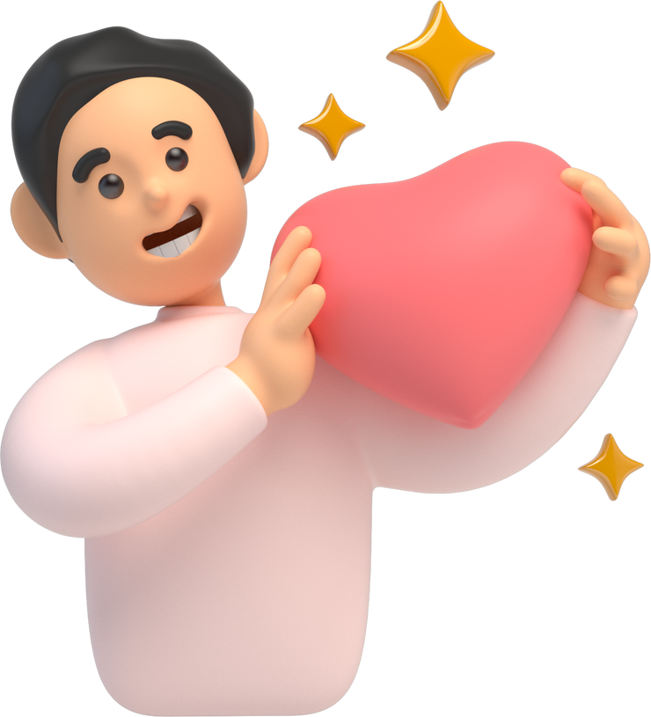
Nicotine is a stimulant, which means that it increases your heart rate, breathing rate and blood pressure.
Over time, the increased blood pressure and heart rate cause damage to the cardiovascular system.
Young people who vape but have never smoked cigarettes are showing early signs of heart disease.

Slide 19
Chemicals from vapes damage the respiratory system. What parts can be affected?
A. Nose & nasal cavity
B. Trachea & Lungs
C. Bronchioles & Alveoli
D. All of the above

Slide 20
Chemicals from vapes damage the respiratory system. What parts can be affected?
A. Nose & nasal cavity
B. Trachea & Lungs
C. Bronchioles & Alveoli
D. All of the above

Slide 21

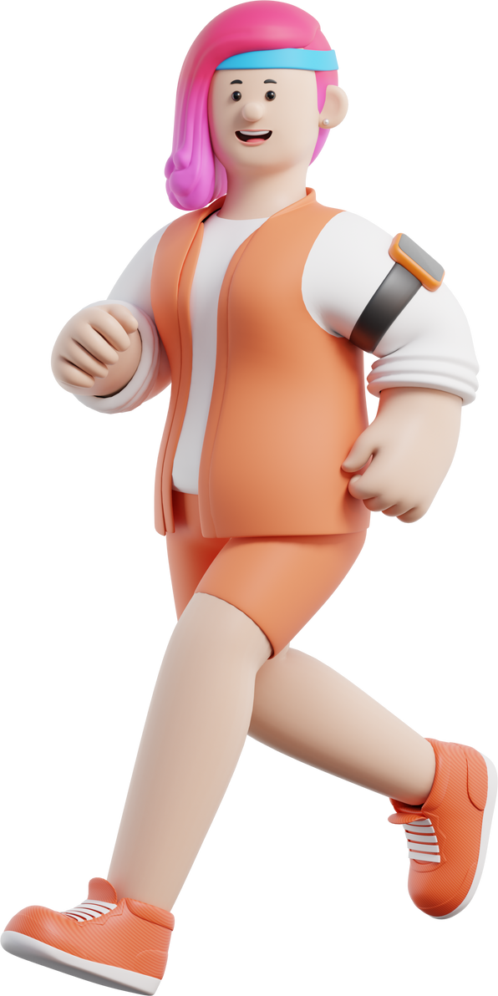
The aerosol that people breathe in while vaping contains chemicals, ultra-fine particles and heavy metals that get inhaled deep into the lungs.
All parts of the respiratory system can be irritated or damaged by the vape aerosol.
This may cause cough, sore throat, inflamed airways (chest pain), and shortness of breath.
The best thing for your lungs is clean, fresh air!

Slide 22
How does vaping affect your mouth & teeth?
A. Cavities
B. Mouth sores
C. Bleeding Gums
D. All of the above

Slide 23
How does vaping affect your mouth & teeth?
B. Cavities
B. Mouth sores
C. Bleeding Gums
D. All of the above

Slide 24

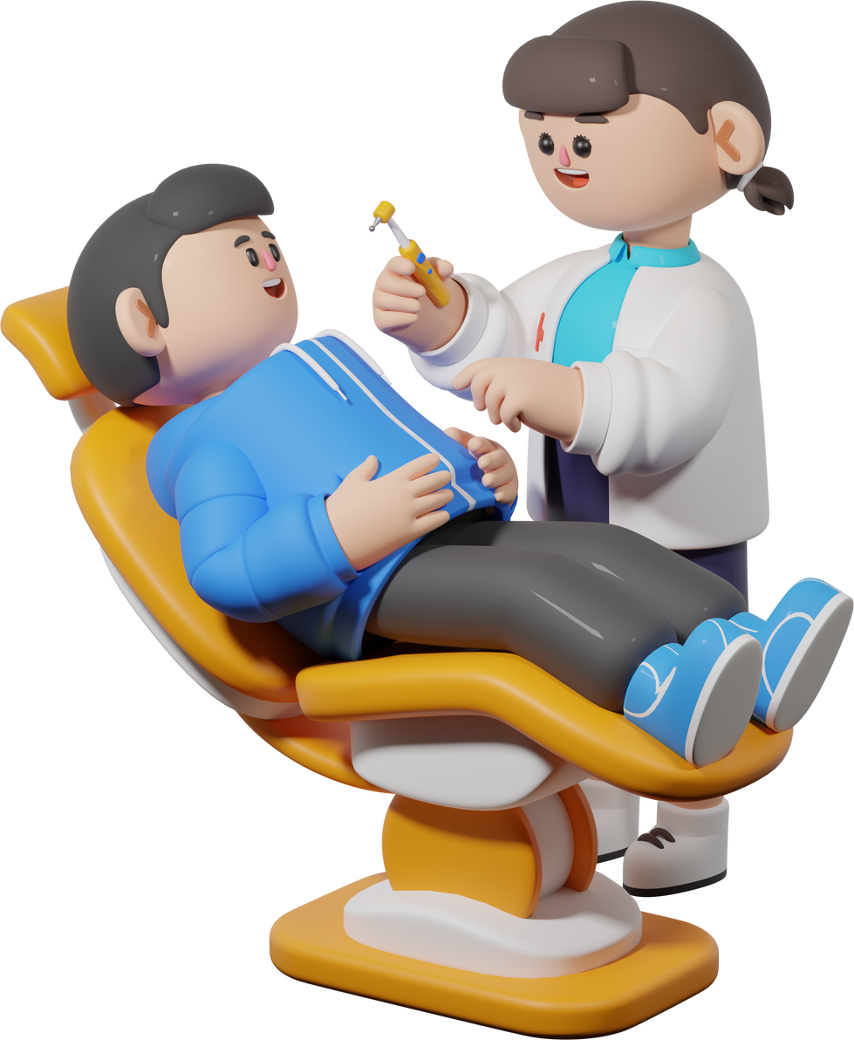
Nicotine reduces blood flow to your gums causing tooth decay and gum disease
Chemicals from vaping irritate the natural bacteria in your mouth. The bacteria produce extra slime to protect themselves. This slime causes inflammation, cavities and bad breath.
Vaping also causes ulcers and sores on lips and mouth.
Overall vaping makes your mouth unhealthy.

Slide 25
Who owns most vaping companies & products, and makes the most money from them?
A. Health Canada
B. Private Businesses
C. Tobacco Companies
D. Pharmaceutical Companies

Slide 26
Who owns most vaping companies & products, and makes the most money from them?
A. Health Canada
B. Private Businesses
C. Tobacco Companies
D. Pharmaceutical Companies

Slide 27


Big Tobacco companies bought the start-up vaping companies. They want all nicotine consumers as their customers, regardless of what products are being used.
Tobacco companies recognize young people as the source of new, long-term customers.
Products are purposefully made to appeal to young people.
Millions of dollars are spent on advertising.

Slide 28
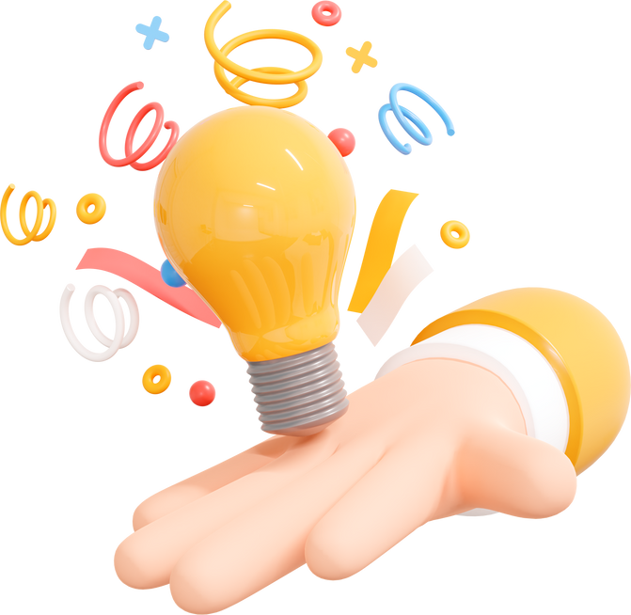
Why make candy and fruit-flavoured e-liquid ?
Share your thoughts....

Slide 29

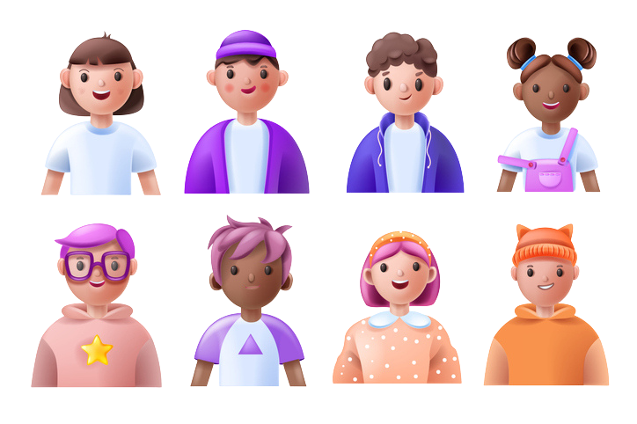
E-liquids are made to appeal to young people in many ways:
- using fruit and candy flavours
- more flavours to try means more experimentation
Vaping devices are also designed with youth in mind:
- using cool tech
- designed to NOT look like cigarettes

Slide 30
Every vape device contains chemicals, plastics and electronics.
The plastics and electronics in vape devices can be recycled.
TRUE
FALSE

Slide 31
Every vape device contains chemicals, plastics and electronics.
The plastics and electronics in vape devices can be recycled.
TRUE
FALSE

Slide 32

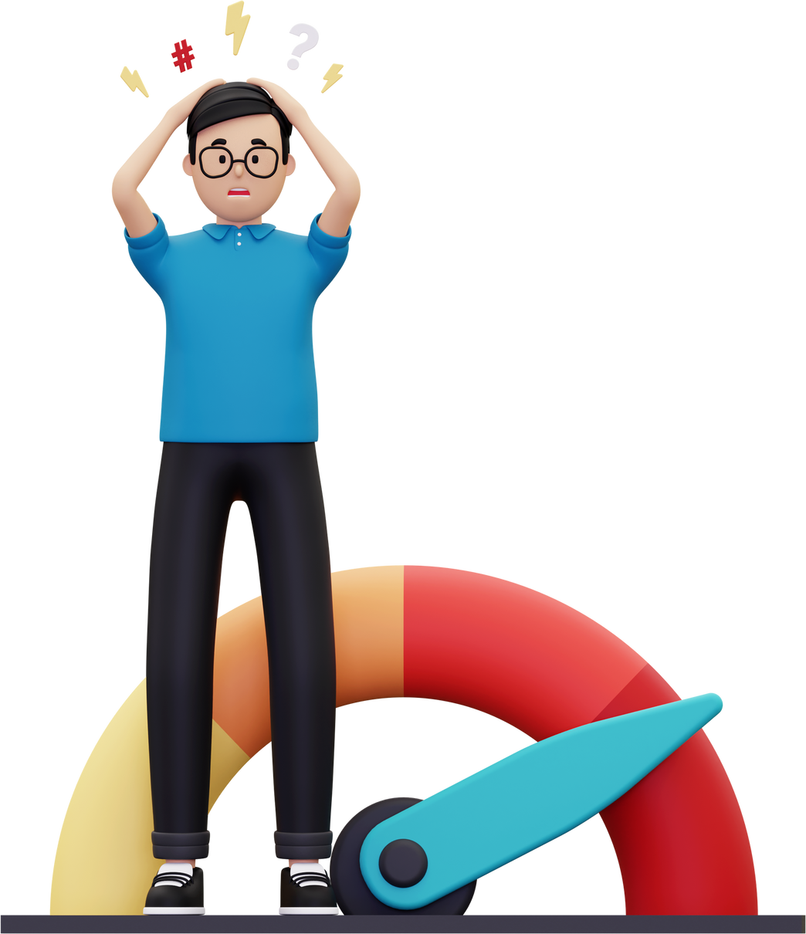
Nicotine and other chemicals contaminate all parts of vaping devices, so that none of the recycable components are suitable for recycling facilities.
Disposable vapes are powered by lithium batteries - but they are never recharged!
Vapes are considered hazardous wastes that:
leak into soil and water
cause fires at recycling and garbage facilities
poison birds, wildlife and fish.

Slide 33


Don’t fall for vaping...
Vaping is not safe.
Vaping can expose you to harmful chemicals.
Vaping can lead to nicotine addiction.
Vaping gets expensive.
Vaping isn’t cool, it’s just the new look of nicotine addiction.
Living vape-free means that you will be healthier and stronger.

Slide 34
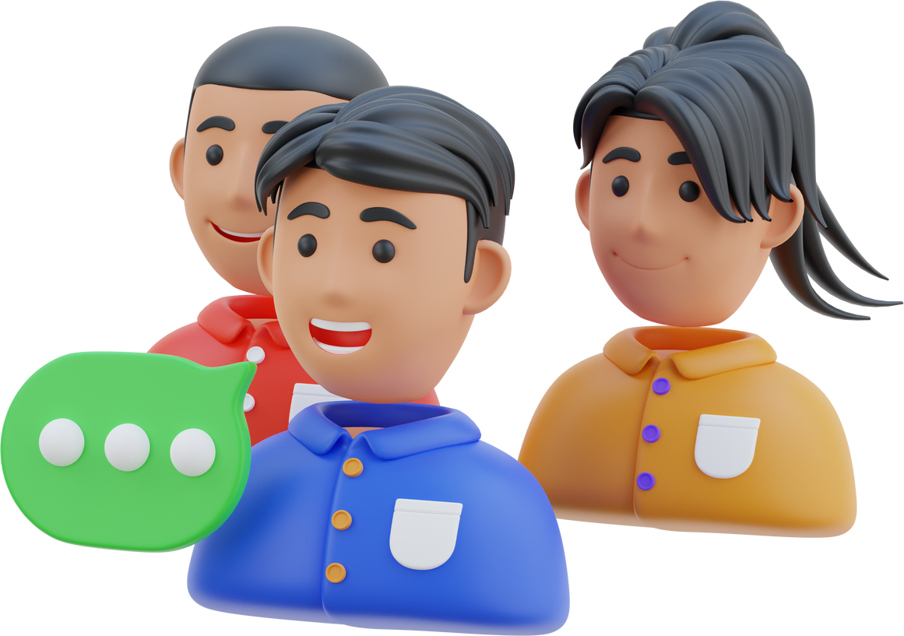
Thanks for listening!
Let’s Talk
If you have any questions after today you can talk to your teacher, guidance counsellor or your parents.
Many people are here to help you.

