Slide 1

Dear Teacher,
This PowerPoint presentation is also available as a Kahoot Game. The questions are the same in each format, so use the resource that your classroom technology can accommodate best.
Link: https://create.kahoot.it/share/2025-vaping-the-ex-files-let-s-explain-vaping-grade-4/a8accf7d-a0a8-4828-b3ec-1aeb7873ac3a
There is a Teacher’s Notes and Answers sheet available to guide you through this presentation, however, we have put that same information in the speaker’s notes section of this presentation , which may be helpful for you too.
With many thanks,
ACT

Slide 2

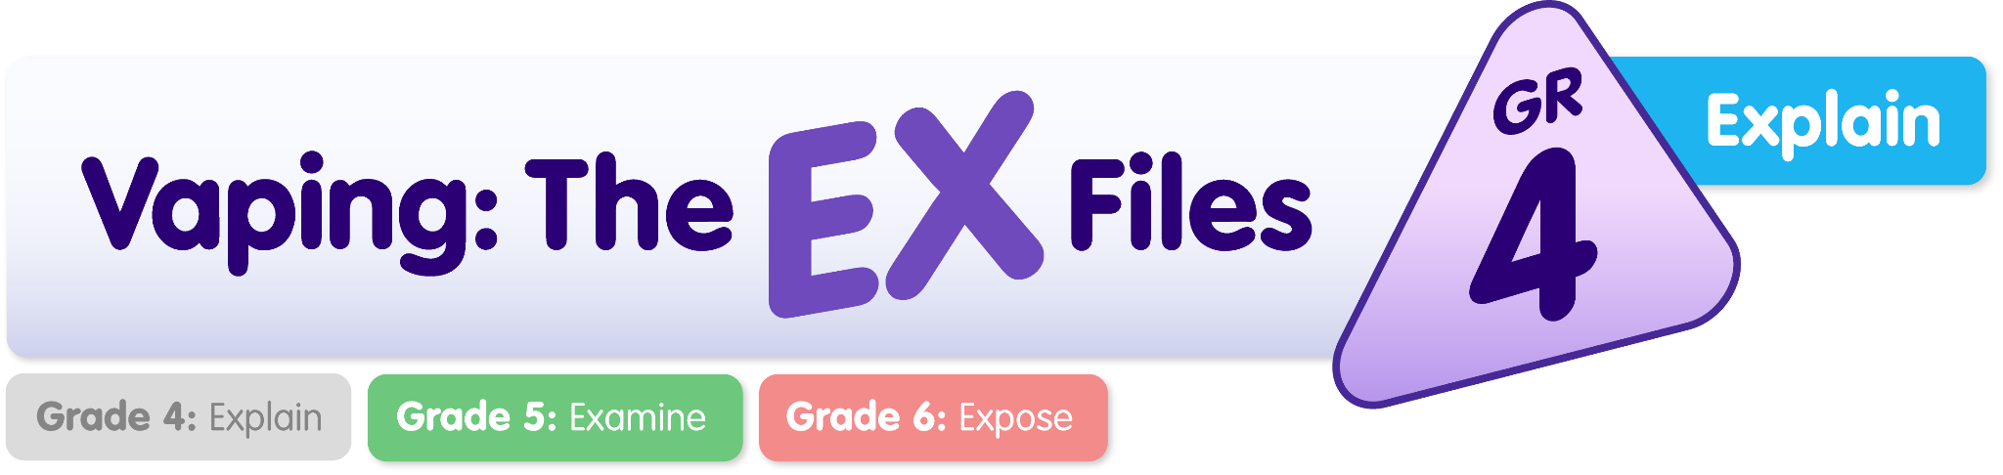
Vaping: The Ex-Files - Let’s EXPLAIN Vaping

Slide 3
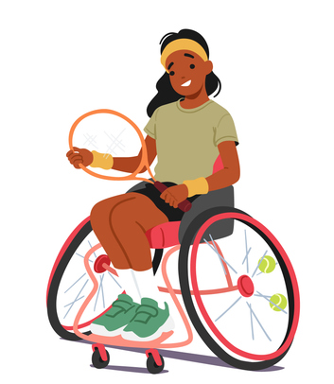
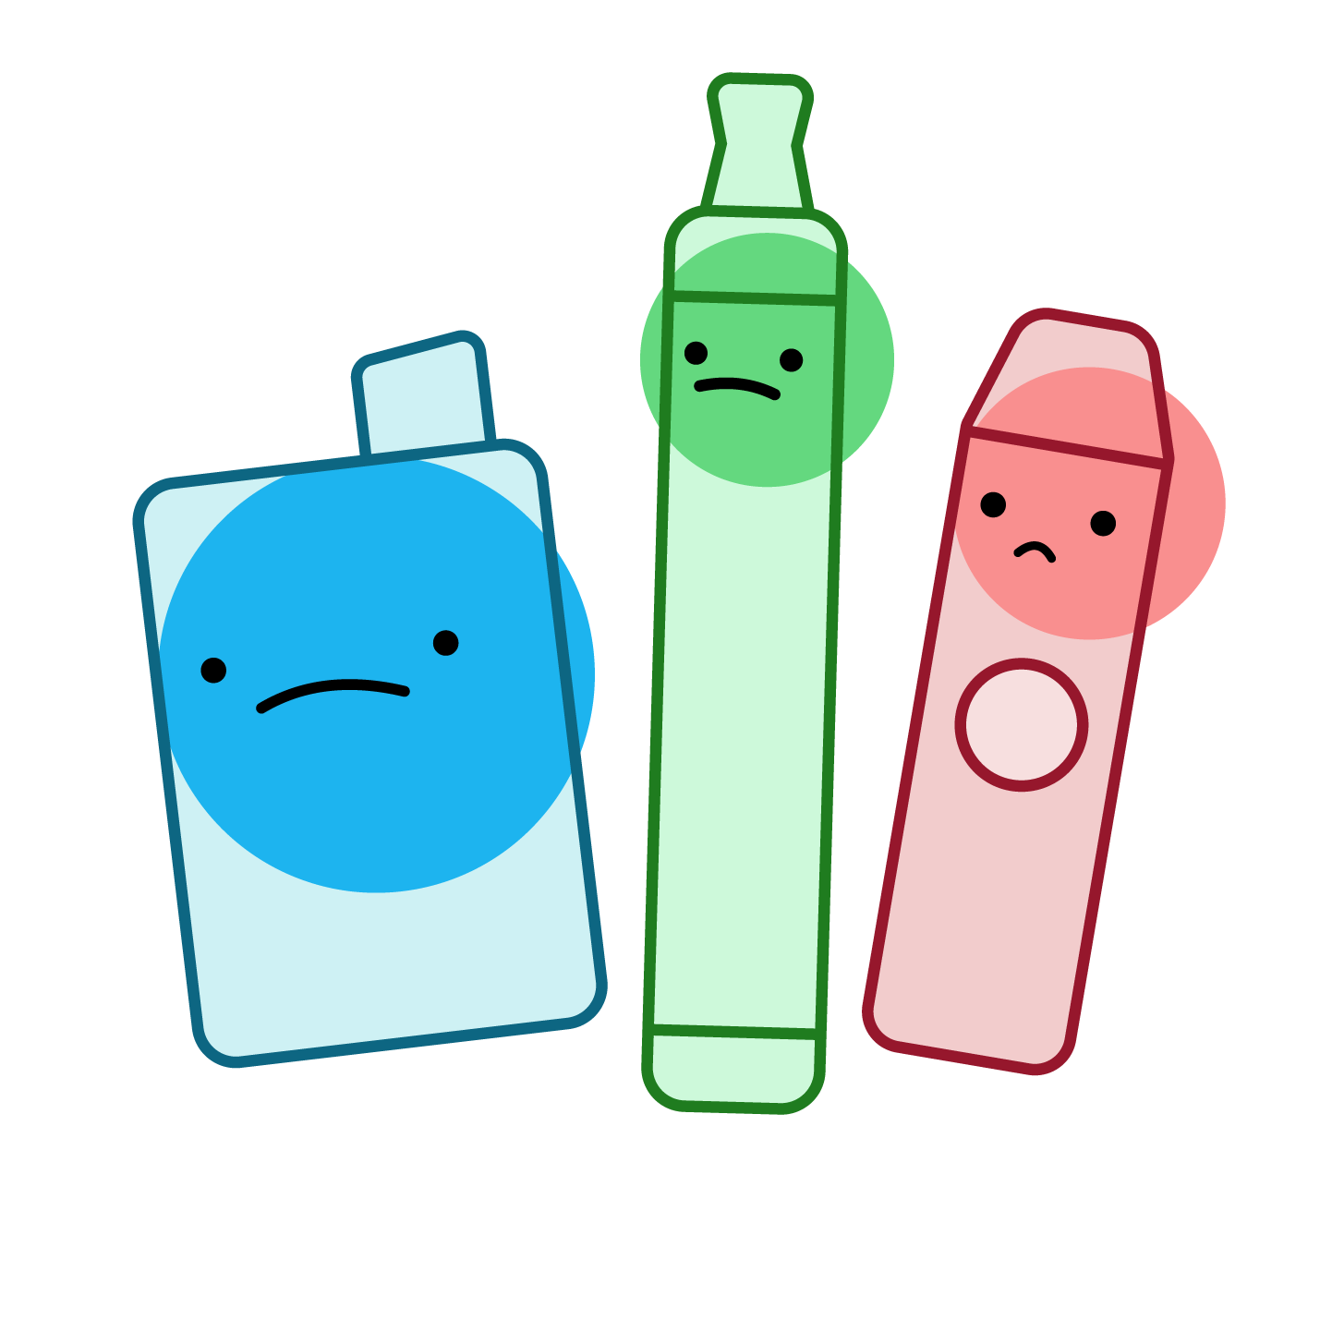
Question 1: What do you need to be healthy?
Healthy food
Safe place to live
Clean air to breathe
All of the above

Slide 4
Question 1: What do you need to be healthy?
Healthy food
Safe place to live
Clean air to breathe
All of the above
Notes:
This question introduces the primary components of healthy living, including clean air to breathe.
Key Message: Your body needs clean air to be healthy and work properly

Slide 5
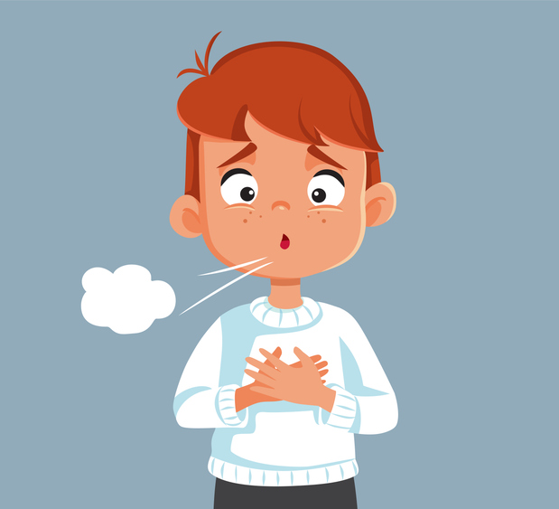
Question 2: What organ makes it possible for you to breathe?
Liver
Lungs
Kidneys
Stomach

Slide 6
Question 2: What organ makes it possible for you to breathe?
Liver
Lungs
Kidneys
Stomach
Notes:
This question is bringing the focus of the lesson towards lungs and how important it is to keep them healthy.
Key Message: Healthy lungs are needed to breathe properly.
IDEAS FOR CLASS PARTICIPATION:
Lead the students through a deep breathing exercise by inhaling for 4 seconds through the nose, hold for 4 seconds, exhale for 4 seconds through their mouth.
Ask students to feel their lungs expand, notice how easy it was because their lungs are healthy.
Ask them how breathing might feel if they were sick, had asthma or if their lungs were damaged.

Slide 7
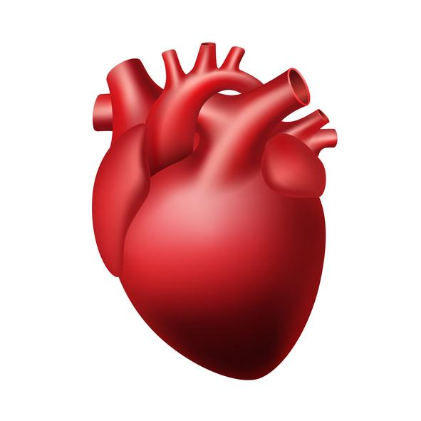
Question 3: What does your heart do?
Pumps blood through your body
Cleans your blood
Controls your feelings
Digests your food

Slide 8
Question 3: What does your heart do?
Pumps blood through your body
Cleans your blood
Controls your feelings
Digests your food
Notes:
This question is introducing the importance of the heart and will tie into subsequent questions concerning vaping and its effect on the heart
Key Message: Your heart is a vital organ that needs to be kept healthy
IDEAS FOR CLASS PARTICIPATION:
Ask students to put their hand over the left side of their chest to feel their heart beating.
Ask them how big do they think it is? It is about the size of their fist!
Ask students if their heart takes a break? Does it stop when they sleep? NO< It keeps beating from the time it started in their mother’s womb, until we die.

Slide 9

Question 4: Which item in this list is a drug?
Chocolate
Nicotine
Oxygen
Sugar

Slide 10
Question 4: Which item in this list is a drug?
Chocolate
Nicotine
Oxygen
Sugar
Notes:
Correct Answer: Nicotine ● Reinforcing the learnings from the health unit, identifying nicotine as a drug. ● Key Message: Nicotine is a drug

Slide 11
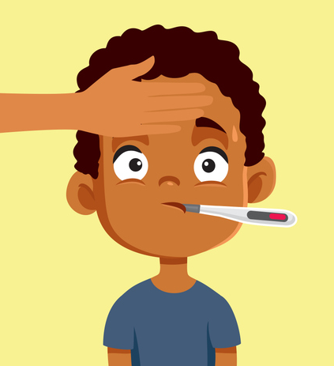
Question 5: Which drug in this list is not used as medicine?
Benadryl
Insulin
Nicotine
Tylenol

Slide 12
Question 5: Which drug in this list is not used as medicine?
Benadryl
Insulin
Nicotine
Tylenol
Notes:
Correct Answer: Nicotine ● Reinforcing the learnings from the health unit, identifying nicotine as a drug. ● Key Message: Nicotine is a drug, it does not have any health benefits. It is not a medicine, even for adults.

Slide 13

Question 6: How much do you know about vaping?
I don’t know much about it
I know a little about it
I know a lot about it
Notes:
7. POLL: Ask Students – How much do you know about vaping?
A discussion opportunity for the teacher to engage the class about their experiences to date about vaping. At grade 4, some students/classes may be more or less aware than others. This poll will help inform the teacher about the classes’ current level of knowledge/exposure.

Slide 14

What is a Vape?
A vape is a device that heats a liquid to create an aerosol that people inhale.
An aerosol is a mix of tiny liquid or solid particles in the air.
Vapes come in different shapes and sizes.
They can look like cigarettes, pens, juice boxes, or memory sticks.
Notes:
An informational slide to ensure that all students have the correct information about vape components and how they work.
There is more information in the Teacher Manual about vape devices and e-liquid if needed.
At the Grade 4 Level, we did not want to overwhelm the students with too much information, so just covering basic information.
If teachers want more information to explain vaping to grade 4 students, you may contact Melissa Moore at ACT: melissamoore@actnf.com

Slide 15

What are people inhaling from a vape?
People who use vapes are inhaling an aerosol. This aerosol is dangerous because it contains:
Nicotine (a drug)
Flavorings
Chemicals
Heavy metals
Notes:
An informational slide to ensure that all students have the correct information about vape components and how they work.
Nicotine is the drug
Flavourings (these are created by using chemicals, not real fruit or juice)
Other chemicals are in the aerosol – things that can hurt their lungs
Heavy metals – Lead, tin, nickel - tiny bits of these metals can be inhaled with the aerosol and they can hurt your body/ make you sick.

Slide 16
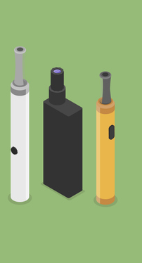

Question 7: What drug is in cigarettes and vapes?
Caffeine
Nicotine
Alcohol
Tylenol

Slide 17
Question 7: What drug is in cigarettes and vapes?
Caffeine
Nicotine
Alcohol
Tylenol
Notes:
Correct Answer: Nicotine ● Key Message: Both cigarettes, which contains tobacco, and vapes where the e-liquid has nicotine added to it, deliver nicotine to the user. It is a very powerful drug that keeps people coming back for more.

Slide 18
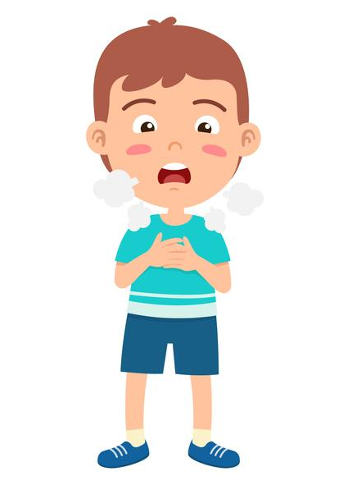
Smoking and Vaping are both Dangerous!
Cigarettes and vapes contain nicotine.
Cigarettes and vapes contain other chemicals that can hurt our bodies.
Both smoking and vaping are harmful to our health.
Notes:
● Cigarettes and vapes both contain a drug (nicotine) and other harmful chemicals. ● Key Message: Inhaling any amount of chemicals is harmful to lungs. Vapes are not safe.

Slide 19
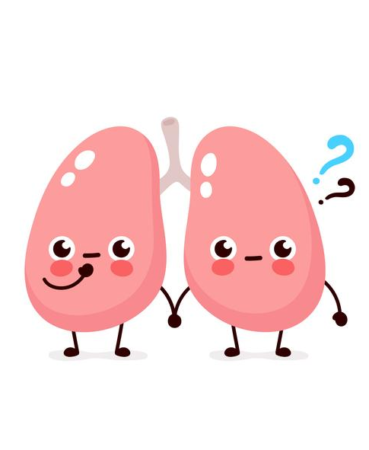
Question 8: What does vaping do to your lungs?
Puts chemicals into your lungs
Makes you breathe deeper
Cleans your lungs out
Makes your lungs shrink

Slide 20
Question 8: What does vaping do to your lungs?
Puts chemicals into your lungs
Makes you breathe deeper
Cleans your lungs out
Makes your lungs shrink
Notes:
This question is connecting the risks of vaping to the respiratory system, which is part of their health and science curriculum.
Key Message: Vaping means that a person is inhaling chemicals and nicotine. Inhaling these things from vaping aerosol can damage a person’s lungs.

Slide 21
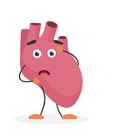
Question 9: What does nicotine do to your heart?
Makes it pump faster
Makes it pump slower
Has no effect

Slide 22
Question 9: What does nicotine do to your heart?
Makes it pump faster
Makes it pump slower
Has no effect
Notes:
This question is connecting the risks of vaping to the circulatory system.
Key Message: Vaping means that a person is inhaling chemicals and nicotine. Inhaling nicotine from vaping increases a person’s heart rate.
NOTE TO TEACHER: Nicotine is a stimulant, which increases blood pressure and heart rate. Over time, this leads to heart disease. Young people who vape (and never smoked cigarettes) are showing early signs of heart disease. The main point is that vaping can hurt your body in different ways.

Slide 23
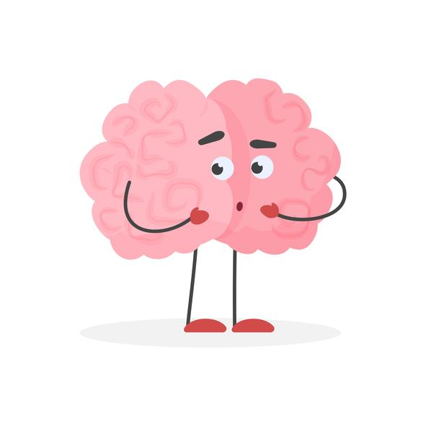
Question 10: Your brain can tell the difference between nicotine from a vape and nicotine from a cigarette.
True
False

Slide 24
Question 10: Your brain can tell the difference between nicotine from a vape and nicotine from a cigarette.
True
False
Notes:
Correct Answer: False
To your brain, the chemical or drug of nicotine is the same, regardless of where it comes from.
Just like vitamin c is the same whether it comes from eating an orange or a lemon. Your mouth recognized a difference, but your body uses it the same, regardless where it came from. ● Key Message: All forms of nicotine are the same to your brain, and cause the same effects on the brain, heart and body, including addiction.

Slide 25
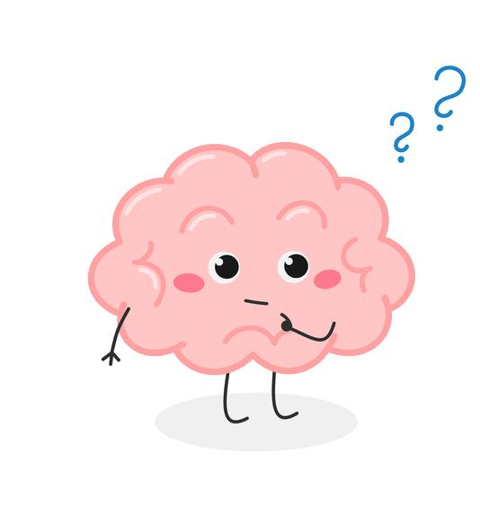
Question 11: What does nicotine do to your brain?
Makes your memory better
Makes learning more difficult
Makes your brain shrink
Has no effect

Slide 26
Question 11: What does nicotine do to your brain?
Makes your memory better
Makes learning more difficult
Makes your brain shrink
Has no effect
Notes:
This question is connecting the risks of vaping to their growth and development, their brain and nervous system.
Key Message: Nicotine from vapes negatively affects your brain and makes it more difficult to learn new things.
TO TEACHER: Nicotine affects young developing brains in many negative ways. Nicotine impairs learning, memory and recall, focus and concentration. Nicotine also reduces impulse control and can cause mood swings, irritability and anxiety .
The younger a person is when they start using or even experimenting with nicotine, addiction can develop faster and be more intense.

Slide 27
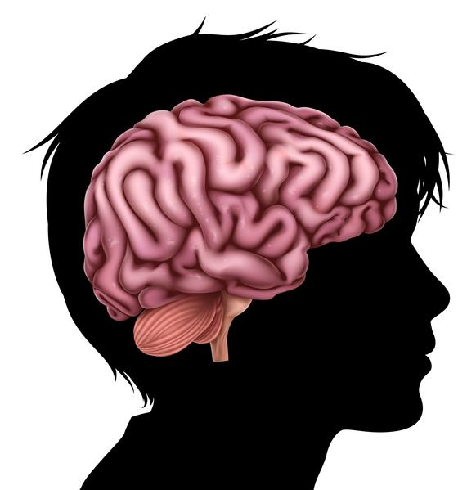
Nicotine and your Brain
Nicotine affects your developing brain
in many ways.
Nicotine makes it harder to learn new things
Nicotine affects your memory
Nicotine causes people to feel stressed and anxious
Nicotine may make you feel sad
Nicotine affects the part of your brain where you make choices and decisions.

Slide 28
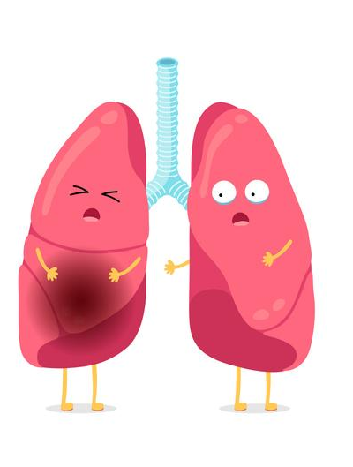
Question 12: Which of the following can
hurt your airways and lungs?
Smoking
Air pollution
Vaping
All of the above

Slide 29
Question 12: Which of the following can
hurt your airways and lungs?
Smoking
Air pollution
Vaping
All of the above
Notes:
Correct Answer: All of the above ● Introducing students to the concept that vaping can also damage your airways. ● Key Message: Vaping can harm your airways and lungs.

Slide 30

Question 13: The aerosol that comes from a vape is just harmless water vapour.
True
False

Slide 31
Question 13: The aerosol that comes from a vape is just harmless water vapour.
True
False
Notes:
● Correct Answer: False ● Many people believe that the aerosol from a vape is just harmless water vapour.
In fact, that aerosol contains many harmful chemicals. It can cause people to have red, watery eyes, sore throats, coughing and asthma attacks.
● Key Message: Vape clouds contain harmful chemicals. It is not water vapour. It is not safe.

Slide 32
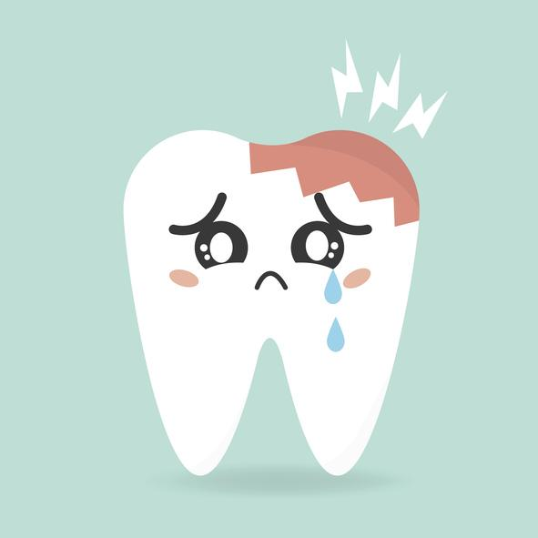
Question 14: Vaping can cause cavities.
True
False

Slide 33
Question 14: Vaping can cause cavities.
True
False
Notes:
The bacteria that normally live inside our mouths do not like the chemicals from vaping. To protect themselves, the bacteria produce a slime to cover themselves as a form of protection. This slime does protect the bacteria, but it softens our enamel, making it easier for cavities to develop.
Key Message: Vaping can cause cavities and harm our oral health.

Slide 34
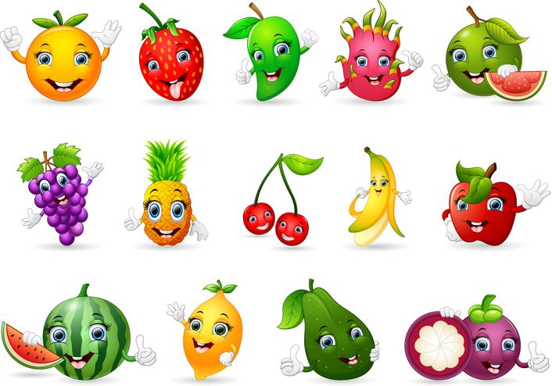

Question 15: Everything that
has a fruity name must have
healthy fruit in it.
True
False

Slide 35
Question 15: Everything that
has a fruity name must have
healthy fruit in it.
True
False
Notes:
Lots of products are named after fruits, but do not contain healthy fruits in them .
Can you name some products like that? Fruit loops, fruit roll-ups, Gatorade and other drinks.
100% fruit juice comes from fruit, and does have some nutrient but it is better only have small amounts of real juice because it has high amounts of sugar. It is healthier to eat the whole fruit to get all the fibre and nutrients, as well as the juice

Slide 36
Why are vape liquids made to taste like candy and fruit flavours?
Flavoured vape liquids make people curious about them = trying more
Fruit names and silly names make people think they are less dangerous
Chemicals are used to make the flavours – there is no real fruit in any vape liquids.
Notes:
Naming vaping liquids after fruit and candy makes young people want to try more flavours, to try the variety. Fruit names may lead children to think that there is no harm in these products – “ how can strawberry splash be dangerous?”
Key Message: Calling vaping liquids after fruit implies that they are not harmful, it attracts children and kids think it is healthier. Using healthy names for vape liquids (which contain chemicals) is dangerous for children.

Slide 37
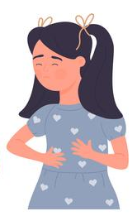
Questions 16: How might vaping harm you?
Cause dry throat, cough and trouble breathing
Affect your brain development
Cause lung and heart problems
All of the above

Slide 38
Questions 16: How might vaping harm you?
Cause dry throat, cough and trouble breathing
Affect your brain development
Cause lung and heart problems
All of the above
Notes:
AS mentioned before, vaping is not safe and it exposes people to chemicals and nicotine.
Because of the chemicals and nicotine, people often have a sore throat, can experience changes in their brain (how they feel, how they learn), and have lung damage or develop heart problems from vaping.
Key Message: Nicotine poses many dangers to children.

Slide 39


Question 17: If you play sports, sing or play a wind instrument, how could vaping impact your performance?
Vaping helps you breath better
Vaping makes breathing more difficult
Vaping helps you breathe deeper
Vaping has no effect on your breathing

Slide 40
Question 17: If you play sports, sing or play a wind instrument, how could vaping impact your performance?
Vaping helps you breath better
Vaping makes breathing more difficult
Vaping helps you breathe deeper
Vaping has no effect on your breathing
Notes:
Vaping makes breathing more difficult which can immediately affect how an athlete, singer, musician can perform. If you can’t breathe well, it will be hard to do your best!
This message might be really meaningful to some students who are doing these kinds of activities.
IDEAS FOR THE TEACHER:
Ask the class : If you are working really hard as an athlete on a team, how would you feel if some teammates are vaping before you go to a really important game?

Slide 41
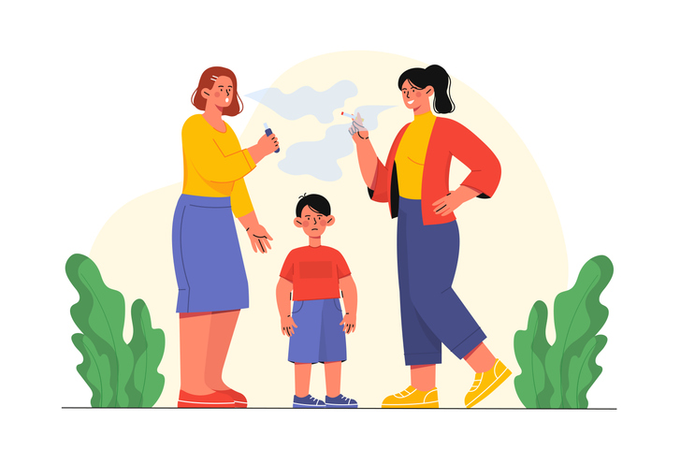
Second-hand Smoke
Second-hand Vapour
Second-hand smoke comes from the burning end of the cigarette AND the smoke that a person exhales while they are smoking.
Second-hand smoke contains many harmful chemicals.
People exposed to second-hand smoke get the same diseases as people who smoke.
Second-hand vapour is the AEROSOL that a person exhales while they are vaping.
Second-hand vapour contains nicotine and other harmful chemicals.
Second-hand vapour can cause people to have itchy / watery eyes, sore throat, headaches and can trigger asthma attacks.

Slide 42
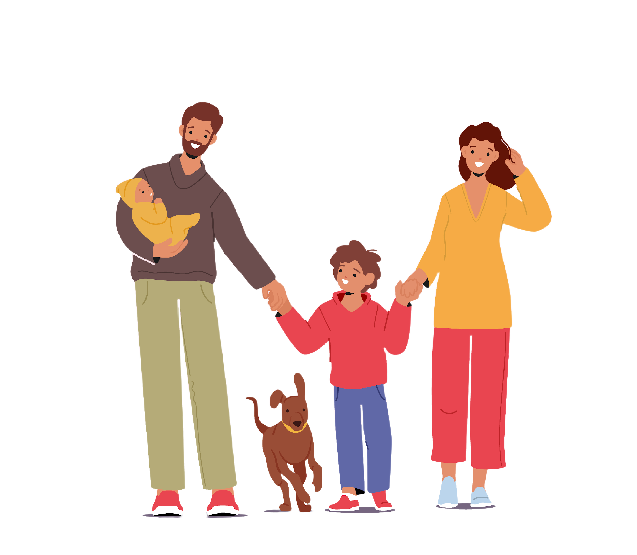
Question 18: Who can be harmed by second-hand smoke or vapour?
Children and babies
Adults
Pets
All of the above

Slide 43
Question 18: Who can be harmed by second-hand smoke or vapour?
Children and babies
Adults
Pets
All of the above
Notes:
Correct Answer: All of the above ● Second-hand smoke includes smoke from the burning tip of a cigarette and well as what is exhaled by users. Second-hand vapour is the aerosol clouds exhaled by users. Vapes do not have a burning tip. Both products contain chemicals that are harmful when inhaled by animals and humans. Unborn babies can be harmed by second hand smoke because they are exposed to the same things as the pregnant mom. ● Key Message: Smoking and vaping are sources of air-pollution and harm humans and animals.

Slide 44

Question 19: What can you do to be as strong and healthy as possible?
Eat fruits & veggies every day
Wear a helmet when on wheels
Play every day
Stay smoke and vape free
All of the above

Slide 45
Question 19: What can you do to be as strong and healthy as possible?
Eat fruits & veggies every day
Wear a helmet when on wheels
Play every day
Stay smoke and vape free
All of the above
Notes:
Correct Answer: All of the above ● To live a long and healthy life, there are things that you should do and things that you shouldn’t do. Discuss other behaviours that can be adopted or avoided. ● Key Message: Reinforcing the healthy choices for healthy living.

Slide 46


Share one new thing that you learned during this game.
Live your best life smoke and vape free!
Remember, nicotine is a drug that can harm you.
Vapes contain nicotine and other harmful chemicals.
Notes:
This concludes this portion of Vaping the EX-Files – Let’s EXPLAIN Vaping.
You may want to discuss what the students found interesting or allow them to ask a few questions.
You can continue with learning activities in the Grade 4 Student Workbook.
Please remember to complete the teacher Feedback form.

